Slide 1
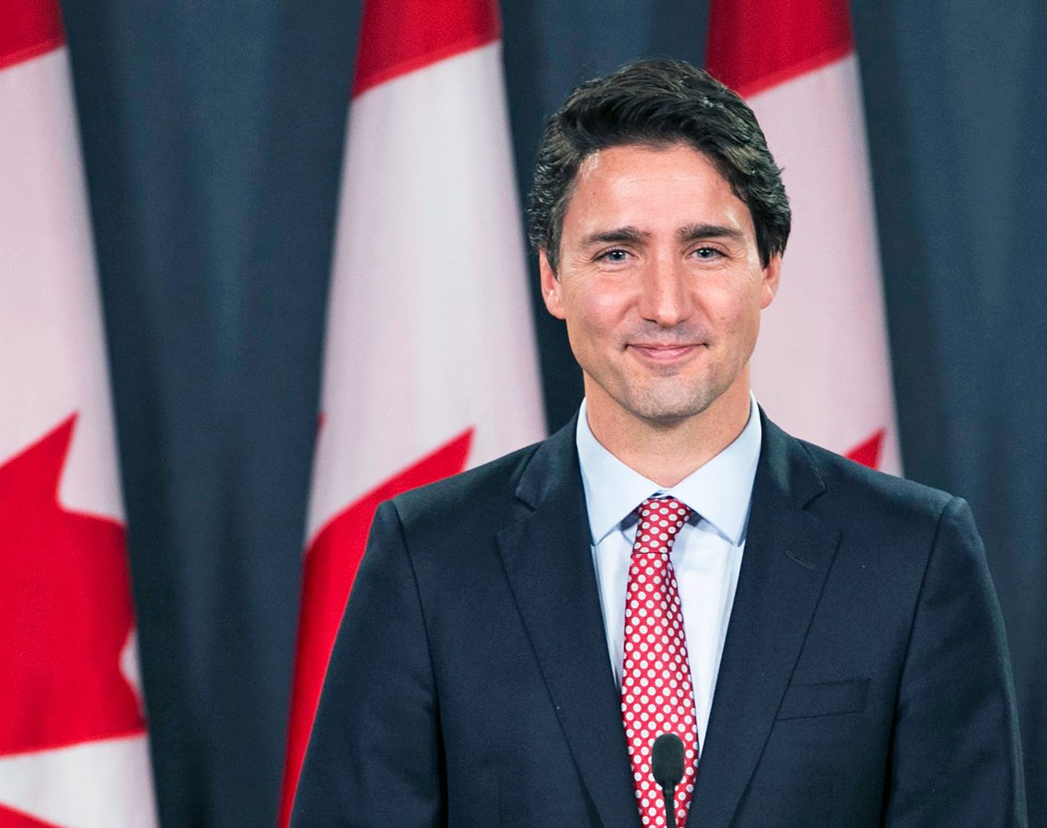
Justin Trudeau
Shinji Kawaguchi
Keisuke Namba
Yuma Akiyoshi
Koharu Wachi
Notes:
https://globalleaderstoday.online/global-100-inspirational-leaders-2024/

Slide 2
Introduction
・Name Justin Trudeau
・Occupation 23rd Canadian Prime Minister
・Political Liberal Party
・Birthday 1971 December 25th
・Term 2015 November 4th –2025 March 14th

Slide 3
Introduction
Why Justin Trudeau?
1.He was Canada's Prime Ministers.
2.He was popular among young people.
3.He had many experiences.

Slide 4
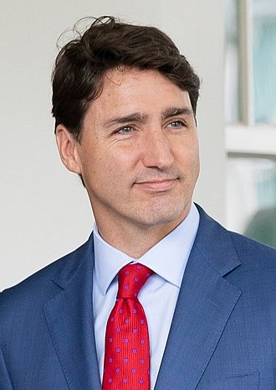
What did Trudeau do
Canadian Prime Minister
1. Gender balance
…promote cultural diversity.
2. First nation
…worked for their rights.
3. Immigrants
…accept immigrants.
4. Covid-19
…response to the pandemic.

Slide 5

Trudeau’s readership style
Charismatic Communication
Sociable, warm and persuasive
Outgoing personality makes him highly sociable and comfortable in public situation.
Focus on Consensus-Building Leadership
Prefers collaboration to conflict
He typically avoids direct conflict, instead trying to bring groups together through diplomatic negotiation.
Source: Khoury & Immelman, 2021, Digital Commons

Slide 6
What makes Justin Trudeau a good leader
Honesty and weakness
01
A human leader
Family-Oriented Values
02
Role as a father and husband
Approachability
03
Youthful
Casual style

Slide 7
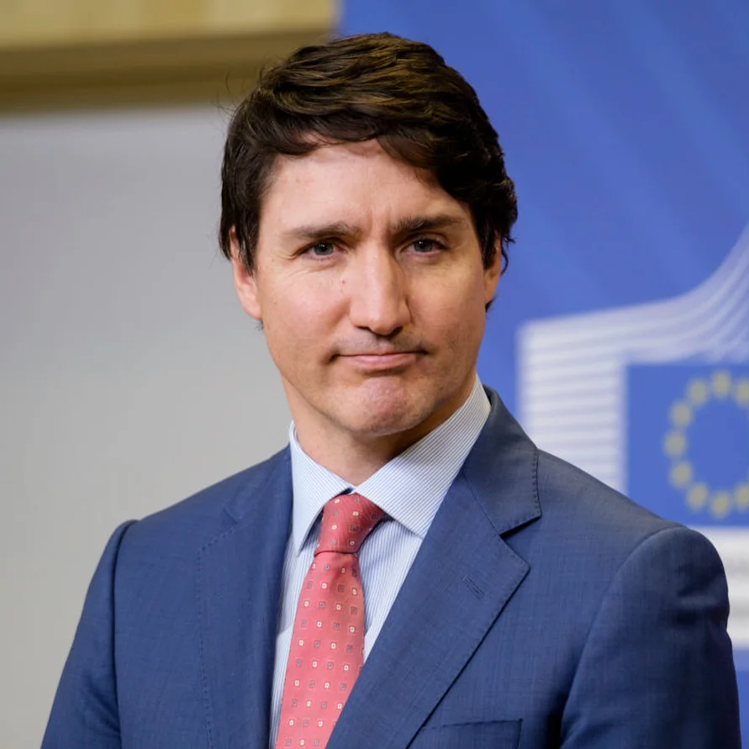
Summary
Father of Canadian!
He led Canada through critical challenges
Charismatic and Approachable Reader

Slide 8
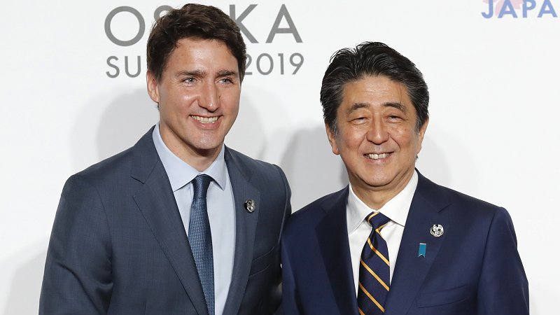
Thank you for listing!

